Slide 1
Welcome
to
MTAC August 2017
Date: August 22, 2017

Slide 2
Welcome and Introductions Co-Chairman Remarks | Steve Monteith– MTAC USPS Chair Erv Drewek – MTAC Industry Chair
Welcome & Opening Remarks Marketing Update Neuroscience of Touch | Megan Brennan, PMG & CEO Jim Cochrane, Chief Customer & Marketing Officer & EVP Daniel Dejan, ETC Print & Creative Manager – SAPPI
Operations Update BREAK | David Williams, Chief Operating Officer & EVP
Addressing Update Pricing Update | Jim Wilson, Director, Addressing & Geospatial Technology Sharon Owens, VP, Pricing & Costing
Workgroups & Task Teams | Various Workgroup Leaders
Closing Remarks | Steve Monteith/Erv Drewek
Date: August 22, 2017

Slide 3
2018 MTAC Proposed Meeting Dates*:
Tuesday: MTAC Leadership Open Session;
Wednesday: Membership assembly, Focus Groups, and Business Session
Thursday: MTAC Leadership and Executive Committee Meetings
February 27-28, March 1
June 12-14
October 2-4
December 4-6
*Subject to change, pending final approval of USPS corporate calendar.

Slide 5
August 22, 2017
USPS Leadership Forum
for Stakeholders
Operations update
David E. Williams
Chief Operating Officer and Executive Vice President

Slide 6
USPS Leadership Forum for Stakeholders
Agenda
Service Performance
MTE Update
Peak Readiness
Questions & Answers

Slide 7
USPS Leadership Forum for Stakeholders
Service Performance

Slide 8
First-Class Composite (Letters/Flats)
 | YTD | Q3TD
Actual | 93.63 | 94.53
SPLY Var | +1.13 | +0.16
96.00
Q4 FY16 | Q1 FY17 | Q2 FY17 | Q3 FY17
94.43% | 91.87% | 92.87% | 94.53%
+2.55 Q4 FY15 | +1.96 Q1 FY16 | +2.07 Q2 FY16 | +0.16 Q3 FY16
Data through June 30, 2017
Notes: Includes Letters, Flats and Parcels. Data through December 31, 2016

Slide 9
First-Class Composite (Letters/Flats)
Proportion of Mail Delivered in Days
 | 0-1 Day | 2 Days | 3 Days | 4 Days | 5 Days | 6+ Days | Avg. Days
FY17 Q3 | 20.7% | 42.4% | 32.5% | 3.2% | 0.7% | 0.6% | 2.2
FY16 Q3 | 19.6% | 44.6% | 31.3% | 3.2% | 0.7% | 0.6% | 2.2
FY17 Q3 thru 06/30/17, FY16 Q3 thru 06/30/16
Composite scores are calculated by combining scores using RPW Weights.

Slide 10
Marketing Mail Composite
 | YTD | Q3TD
Actual | 90.95 | 92.70
SPLY Var | +3.00 | +0.64
91.00
Q4 FY16 | Q1 FY17 | Q2 FY17 | Q3 FY17
92.37% | 89.30% | 91.12% | 92.70%
+5.47 Q4 FY15 | +4.51 Q1 FY16 | +3.40 Q2 FY16 | +0.64 Q3 FY16
Data through June 30, 2017
Notes: Includes Letters, Flats and Parcels. Data through December 31, 2016

Slide 11
Marketing Mail Composite
Proportion of Mail Delivered in Days
 | 0-1 Day | 2 Days | 3 Days | 4 Days | 5 Days | 6+ Days | Avg. Days
FY17 Q3 | 13.4% | 35.0% | 27.1% | 13.8% | 3.8% | 6.9% | 3.0
FY16 Q3 | 13.0% | 34.6% | 26.2% | 14.2% | 4.3% | 7.7% | 3.0
FY17 Q3 thru 06/30/17, FY16 Q3 thru 06/30/16

Slide 12
Periodicals Composite
 | YTD | Q3TD
Actual | 85.12 | 87.98
SPLY Var | +6.18 | +4.29
91.00
Q4 FY16 | Q1 FY17 | Q2 FY17 | Q3 FY17
83.66% | 81.83% | 85.46% | 87.98%
+6.13 Q4 FY15 | +7.49 Q1 FY16 | +6.67 Q2 FY16 | +4.29 Q3 FY16
Data through June 30, 2017
Notes: Includes Letters, Flats and Parcels. Data through December 31, 2016

Slide 13
Periodicals Composite
Proportion of Mail Delivered in Days
 | 0-1 Day | 2 Days | 3 Days | 4 Days | 5 Days | 6+ Days | Avg. Days
FY17 Q3 | 69.9% | 11.3% | 6.8% | 4.4% | 2.4% | 5.2% | 1.7
FY16 Q3 | 69.3% | 12.3% | 5.8% | 3.5% | 2.4% | 6.5% | 1.8
FY17 Q3 thru 06/30/17, FY16 Q3 thru 06/30/16

Slide 14
Service Performance Summary
Continued Focus
Compliance to Operating Plan and 24hr Clock
Mitigate Air Capacity Constraints
Align and Optimize Surface Transportation
Reduce WIP Cycle Times
Focus on Last Mile Opportunities
Intense Focus on Vital Few Opportunities
Ensure Employee & Industry Engagement

Slide 15
USPS Leadership Forum for Stakeholders
MTE Update

Slide 16
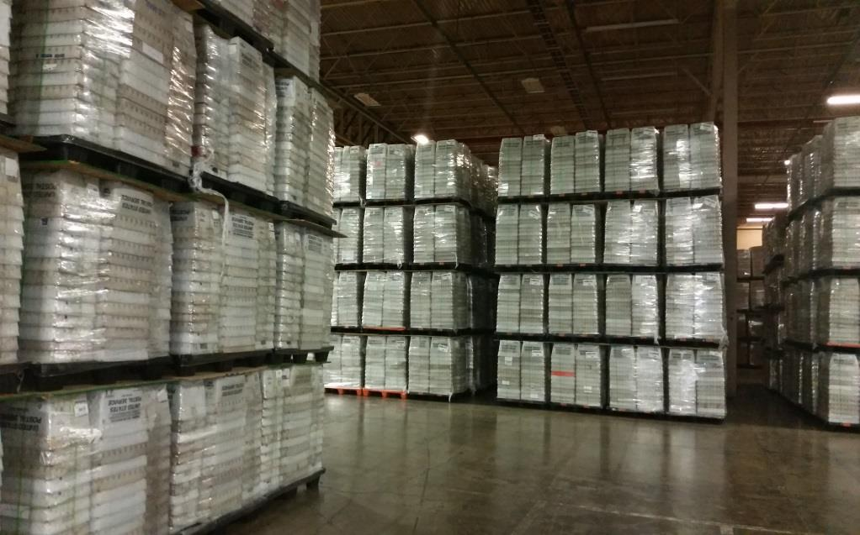
MTE Inventory
USPS Has Spent $61.5M YTD on MTE New Buys
Plastic Trays and Sleeves, Pallets, Plastic Flat Tubs, and Sacks
MTE Inventory Available today
6.24 Million EMM Trays & Sleeves
6.45 Million MM Trays & Sleeves
2.68 Million Half-Trays & Sleeves
1.59 Million Pallets
1 Million Pallets on order
4.09 Million Flat Tubs
3.74 Million Sacks

Slide 17
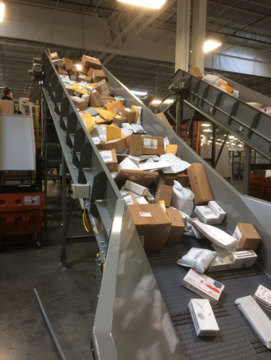
August 22, 2017
Peak Season Readiness

Slide 18
New for Fall 2017
28 Automated Package and Bundle Sorters (APBS) expanded for a total of 1,344 additional separations
2 Automated Package Processing Systems (APPS) expanded for a total of 144 additional separations
7 Small Package Sorter Systems (SPSS)
Queens NY: High Throughput Parcel Sorter (HTPS) with 400+ separations and bulk induction. Dispatch uses pallet elevator and AGVs
3 New Universal Sorters (USS), 3 LCUS induction upgrades, 3 LCUS bin upgrades

Slide 19
New for Fall 2017
3 APBS Induction Systems
2 Parcel Singulators on Rapistan L&DC sorters
6 NDC PSM Return to Keyer upgrades
2 NDC PSM Flats Culling Systems
5 Sort to Monitor, 7 Sort to Light systems for manual operations

Slide 20
New for Fall 2017
150 Dimensioning Scanning Devices for short paid detect
4 additional Automated Delivery Unit Sorters (ADUS) sites
8,300 minivans, scheduled to be sold have been retained
5,000 2-tons, scheduled to be sold have been retained

Slide 21
Partnership
USPS – Industry Collaboration
Exchange Ideas & Preempt Issues
Areas Inspiring Mail Groups
MTAC
PCC Meetings
NPF
Drive Innovation and Adopt Technology
Committed to Collaboration/Communication
Opportunities:
Areas Inspiring Mail Focus Groups – Calendar by Area
https://ribbs.usps.gov/index.cfm?page=periodicalsfocus
http://postalpro.usps.com/industry-forum/area-mailing-industry-focus-group/calendar
Growing Together
National PCC Week: September 25-29, 2017
NPF 2018 – San Antonio, TX May 6-9
http://www.npf.org
MTAC – Meet Quarterly
https://ribbs.usps.gov/index.cfm?page=mtac

Slide 22
USPS Leadership Forum for Stakeholders
Thank You
Questions?

Slide 24
MTAC
August 22, 2017
Enterprise Analytics
Addressing & Geospatial Technology

Slide 25
Addressing Technology
Addressing Topics Update
CASS Cycle O Planning
Streamlining Hardcopy Address Correction Fulfillment Notices
Improving Change-of-Address Data
Enhancements to Internet Change-of-Address (ICOA) Website
25

Slide 26
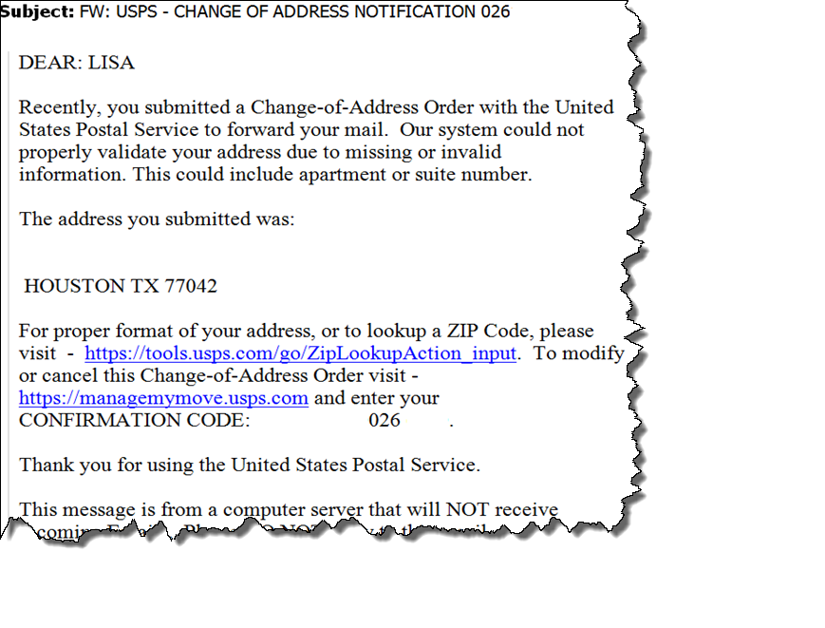
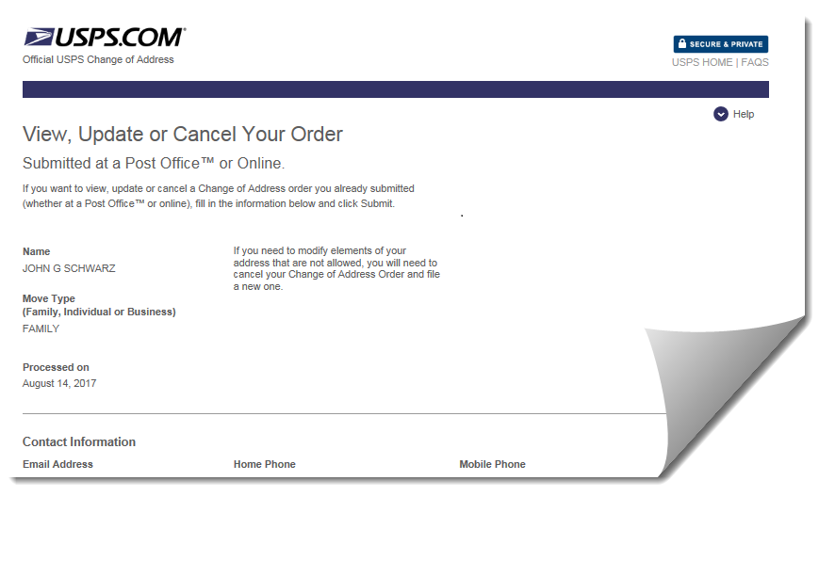
Addressing Technology
Improving Change-of-Address Data
Internet Change-of-Address customers submitting incomplete or unknown addresses sent email requesting additional information.
Customer directed to USPS website to update their address information.
26

Slide 27
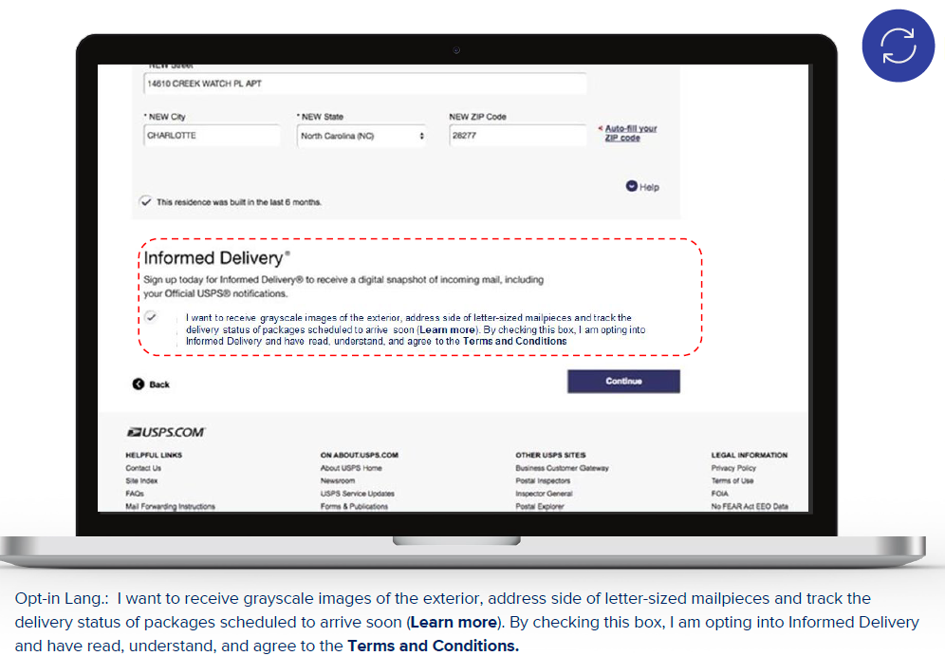
Addressing Technology
ICOA Website Enhancements
Informed Delivery® call-to-action at end of change-of-address entry
Contextual address entry to enhance customer ease-of-use
27

Slide 28
Geospatial Analytics
Geospatial Topics Update
Eclipse Story Map
USPS Interactions with Other Federal Agencies
Geospatial Analytics Initiatives
28

Slide 29
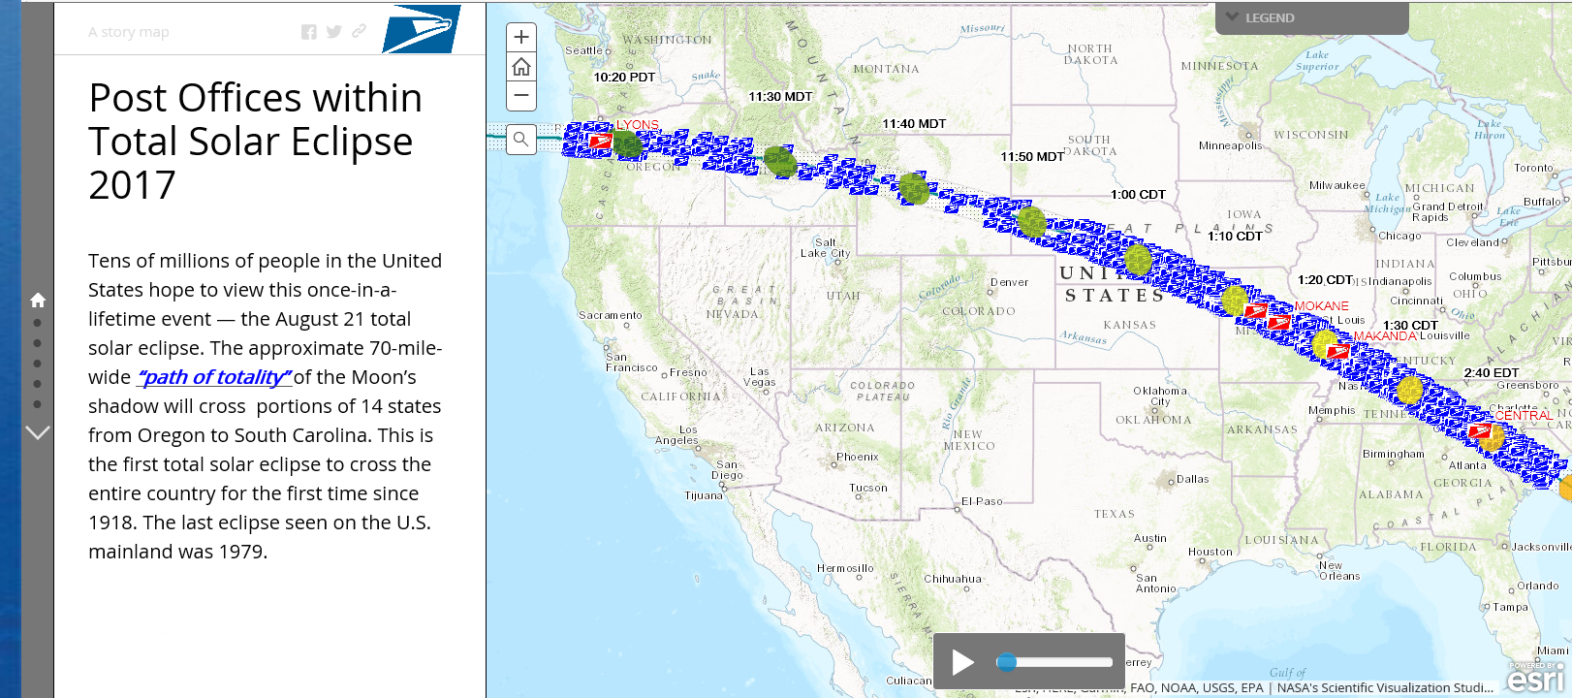
Geospatial Analytics
Total Eclipse of the Sun
“Path of Totality”
online map
29

Slide 30
Geospatial Analytics
online map
30

Slide 31
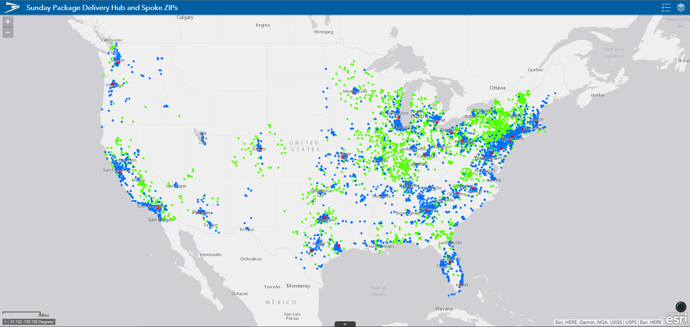
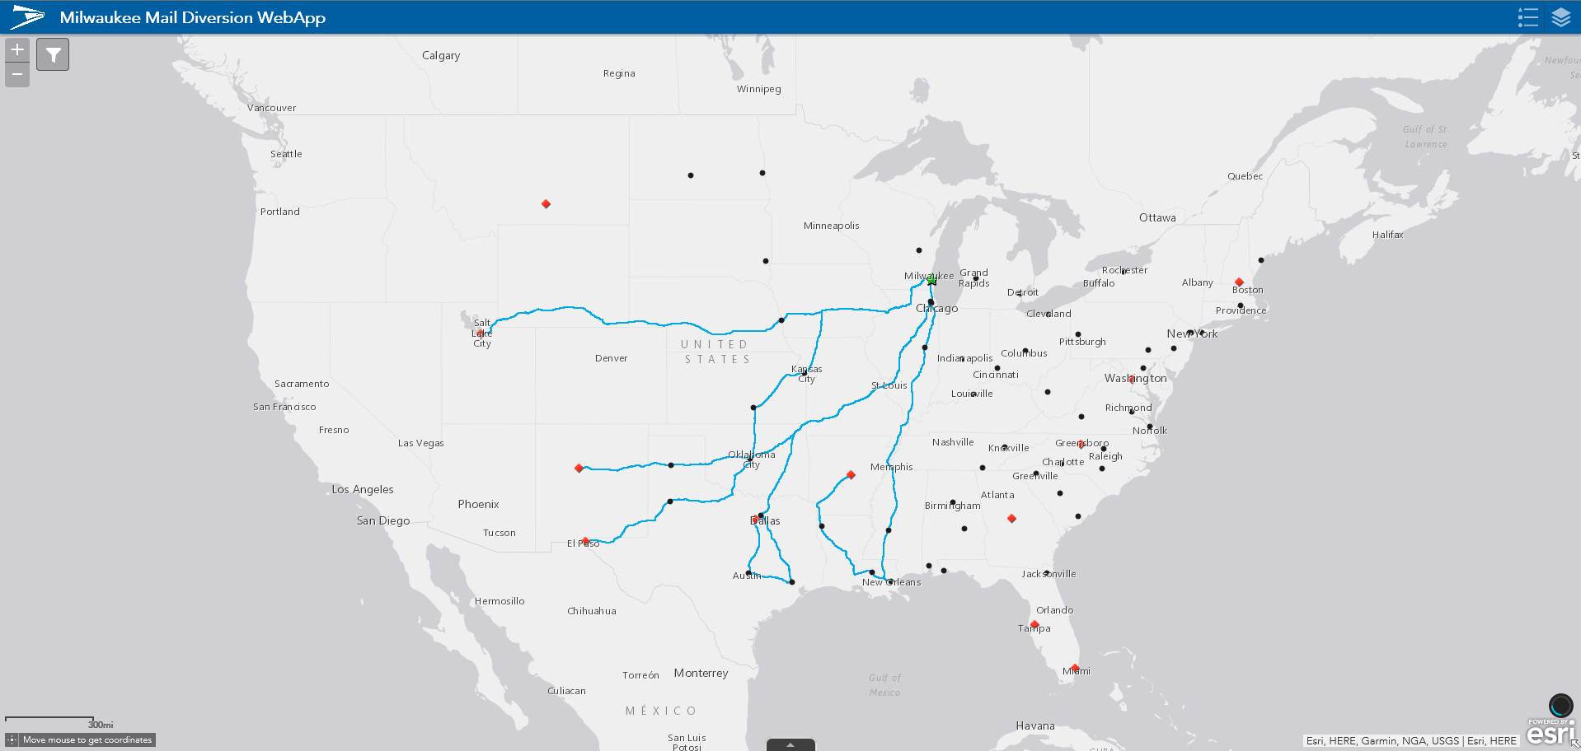
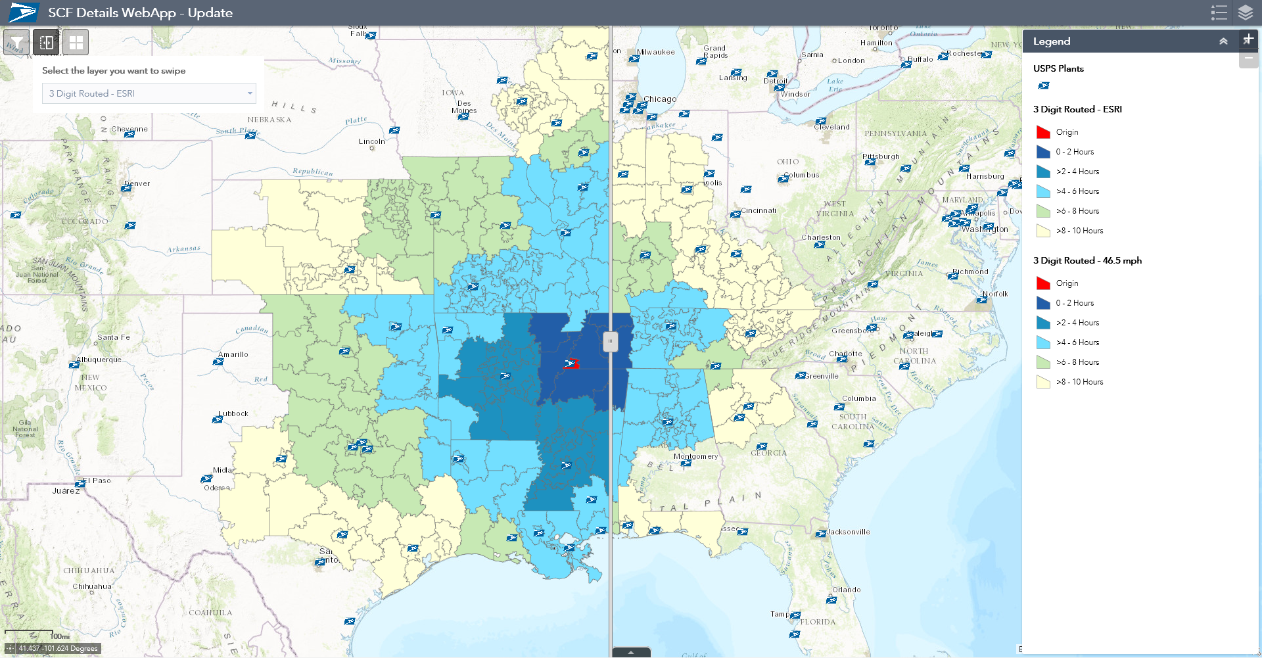
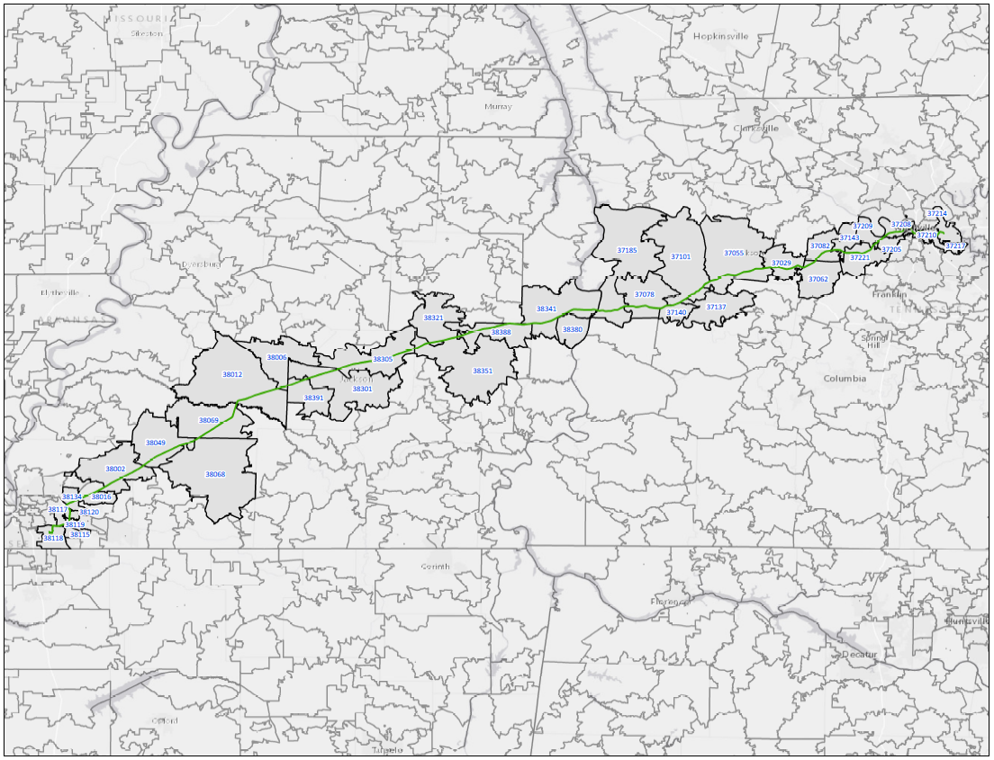
Geospatial Analytics
Geospatial Analytics
Sunday Delivery
Mail Diversion
Geospatial Analytics works closely with other USPS® organizations to provide GIS analysis & research.
Distance equated using ESRI Routing speeds
Distance equated using Standard 46.5 mph speeds
Service Standard
Pharma Project
Analysis

Slide 32
Thank You
Questions?

Slide 34
January 2018
Market Dominant
Price Change

Slide 35
Pricing Strategy
Most products 2% increase +/- 1%
Use available information to produce best financial outcome
Considering public policy and regulatory requirements
Maintain key rate relationships for stability and to gauge market response
Address workshare discounts over 100%
Bring most pass-throughs to or below 100%
Justify those pass-throughs that remain over 100%

Slide 36
Pricing Strategy: First-Class Mail
Single Piece
Letters – Increase near CPI
Flats – Two times the price of SP Letter which allows consumers to apply two stamps
Additional Ounces – No change
Meter Mail - Maintain 3 cent meter gap for market stability
Presort
Letters – Solve for remaining cap space
Letter Gaps – Presort discounts remain stable
Flats – Narrow pass-throughs
FCM Retail Parcels – Move to competitive on Sept. 3, 2017
Operational Changes
Simplify Postage Statement for FC Residual
Removed two lines from Postage Statement
Mail on removed lines will be merged and entered on new line at blended rate
Changes designed to simply FC Postage Statement and increase ease of use
Limit goods in letter & flat shaped items – FCMI, IPA, and ISAL
Only documents in letters/flats under new Universal Postal Convention

Slide 37
Pricing Strategy: USPS Marketing Mail
Letters – Most rate categories increase near CPI
High Density Letters – Above average to shrink gap between HD and 5D
Narrow letter dropship as required by PRC
Commitment to reduce passthroughs by at least 10 percentage points
No major changes to other Presort discounts
Nonprofit – NP Letters receive higher than average increase
Carrier Route, HD and Sat. Flats - below average increases, encourage continued mail use for marketing activities
Spread between presort levels (from 5D DSCF piece rate) may widen
Flats – 105% of Cap as directed by the PRC
Presort Gaps maintained at current levels
Operational Changes
Order of pallet preparation for CR Pallets in non-FSS zones
Updating the order of pallet preparation to increase number of pure CR Pallets
Incent direct pallets to avoid bundle sorting

Slide 38
Pricing Strategy: Periodicals
Inside County - receives average increase
Outside County
Pound rate element – No increase
Piece rate element – Above average increase
Bundle element – Above average increase
Sacks element – Above average increase to incent operational efficiency
Operational Changes
Order of pallet preparation for CR Pallets in non-FSS zones
Updating the order of pallet preparation to increase number of pure CR Pallets
Incent direct pallets to avoid bundle sorting

Slide 39
Pricing Strategy: Package Services
All products increase approximately 2%
Operational Changes
Add BPM Flats to Comail
Allows BPM Flats to be added to comail structure with USPS Marketing Mail and Periodicals
Must be entered at DSCF and DDU
Provides service standard clarity

Slide 40
Questions?

Slide 41
Workgroups Closing

Slide 42
MTAC Workgroup 168: FSS Multi-Scheme Pallets

Slide 43
WG168: FSS Multi-Scheme Pallets Overview
Timeline: February 2015 – July 2017
Leaders: Susan Pinter, Paul Mitchell
Issue statement: Opportunity identified to reduce quantity of low volume scheme pallets resulting from the 250 pound minimum under FSS preparation rules. Modifications to the FSS Stand Alone Mail Prep (SAMP) are being tested which would facilitate sorting and prepping multiple schemes from a single pallet. Impacts and opportunities must be evaluated from all perspectives to ensure successful implementation.

Slide 44
WG168: FSS Multi-Scheme Pallets Recommendations
Eliminate the FSS pure scheme pallet
Eliminate FSS facility pallet
Flats not presorted to multi-scheme would sort to SCF pallet
Require multi-scheme pallets at 500 pounds, optional at 250 pounds
Conduct further discussions on labeling lists for multi-scheme
Modify L006 or create new list for scheme bundle vs. pallet
Maintain current labeling list release schedule
Investigate opportunities to combine multi-scheme and High Speed Flats Feeder (HSFF)

Slide 46
MTAC WG #177
Improvements in Address Quality Methodologies and ACS Best Practices
Notes:
46

Slide 47
WG Structure
USPS Leadership – Kai Fisher
Industry Leadership – Lisa Bowes
Attendees represented
mail owners
mail service providers
address service providers
USPS experts
Weekly telecons

Slide 48
WG Issue Statement
In 2006 in response to a PMG challenge of reducing UAA mail by 50%, MTAC Workgroup 97 presented over a dozen best practices in address quality methodologies. Since then, there have been improvements in data quality tools, expanded access to data, and a better awareness of the impact UAA has on mail deliverability and value. This workgroup will review both the efforts of Workgroup 97 and other industry white papers and put forth an updated Guide to Address Quality Methodologies that reflect improvements in technology and best practices. The workgroup would additionally review the AMEE Address Change Services whitepaper, and work with stakeholders to provide an updated document reflecting current rules and industry/USPS best practices suggestions.

Slide 49
WG Desired Results
Review the recommendations of prior address quality MTAC Workgroups
Review industry white papers on address and data quality methodologies
Present an updated MTAC Report that captures the latest in Address Quality Methodologies
Present an updated ACS Best Practices guide to supplement current ACS Technical Guides in order to encourage further use and application of ACS and ACS data in order to reduce UAA mail.

Slide 50
Address Quality Methodologies

Slide 51
Best Practices for ACS

Slide 52
Recommendations
Review both docs annually each October, first reviews October 2017, via a MTAC task team
Update and republish accordingly
Update doc version, date, and provide a change log with the docs
Update docs out of cycle if there are major changes between Annual Review cycles
Post both docs to RIBBS and PostalPro
Promote use. Advertise the docs via Postal Link, PCC, Industry Alert, MTAC, and NPF promotions

Slide 54
MTAC Workgroup #179 PostalOne! Roadmap
August 22, 2017
The Postal Service captured all industry feedback over the course of the Work Group, categorized by the type of mailer (letters, flats, parcels).
Group Leaders:
Industry: Kurt Ruppel, IWCO Direct kurt.ruppel@iwco.com
USPS: Vicki Bosch, USPS vicki.m.bosch@usps.gov
Defining the path forward for PostalOne!

Slide 55
MTAC Workgroup #179 – PostalOne! Roadmap
Objective #1: Desired Result
Identify critical challenges with PostalOne! including eVS.
Pain points for letters, flats, and parcels were identified.
Pain points have been mapped to the future micro services .
Further discussion and prioritization will occur in WG 182 (Package Platform), WG 183 (Business Customer Gateway), and WG 184 (Customer Identity).
Objective #2: Desired Result
Define key business needs for letters/flats and parcels to improve acceptance and payment experience.
Business needs for letters, flats, and parcels were identified.
Business needs have been mapped to the future micro services .
Further discussion and prioritization will occur in WG 182 (Package Platform), WG 183 (Business Customer Gateway), and WG 184 (Customer Identity).
Objective #3: Desired Result
Define key performance criteria.
Performance criteria for letters, flats, and parcels were identified.
Performance criteria has been mapped to the future micro services .
Further discussion and prioritization will occur in WG 182 (Package Platform), WG 183 (Business Customer Gateway), and WG 184 (Customer Identity).

